Slide 1
Notes:
Úvodní slide obecný. Použijte pouze jeden úvodní slide, druhý smažte.

Slide 2
Hyper Learning Binary Dragonfly Algorithm for Feature Selection: A COVID-19 Case Study
Ústav automatizace a informatiky
Fakulta strojního inženýrství
Vysoké učení technické v Brně
Martin Juříček

Slide 3


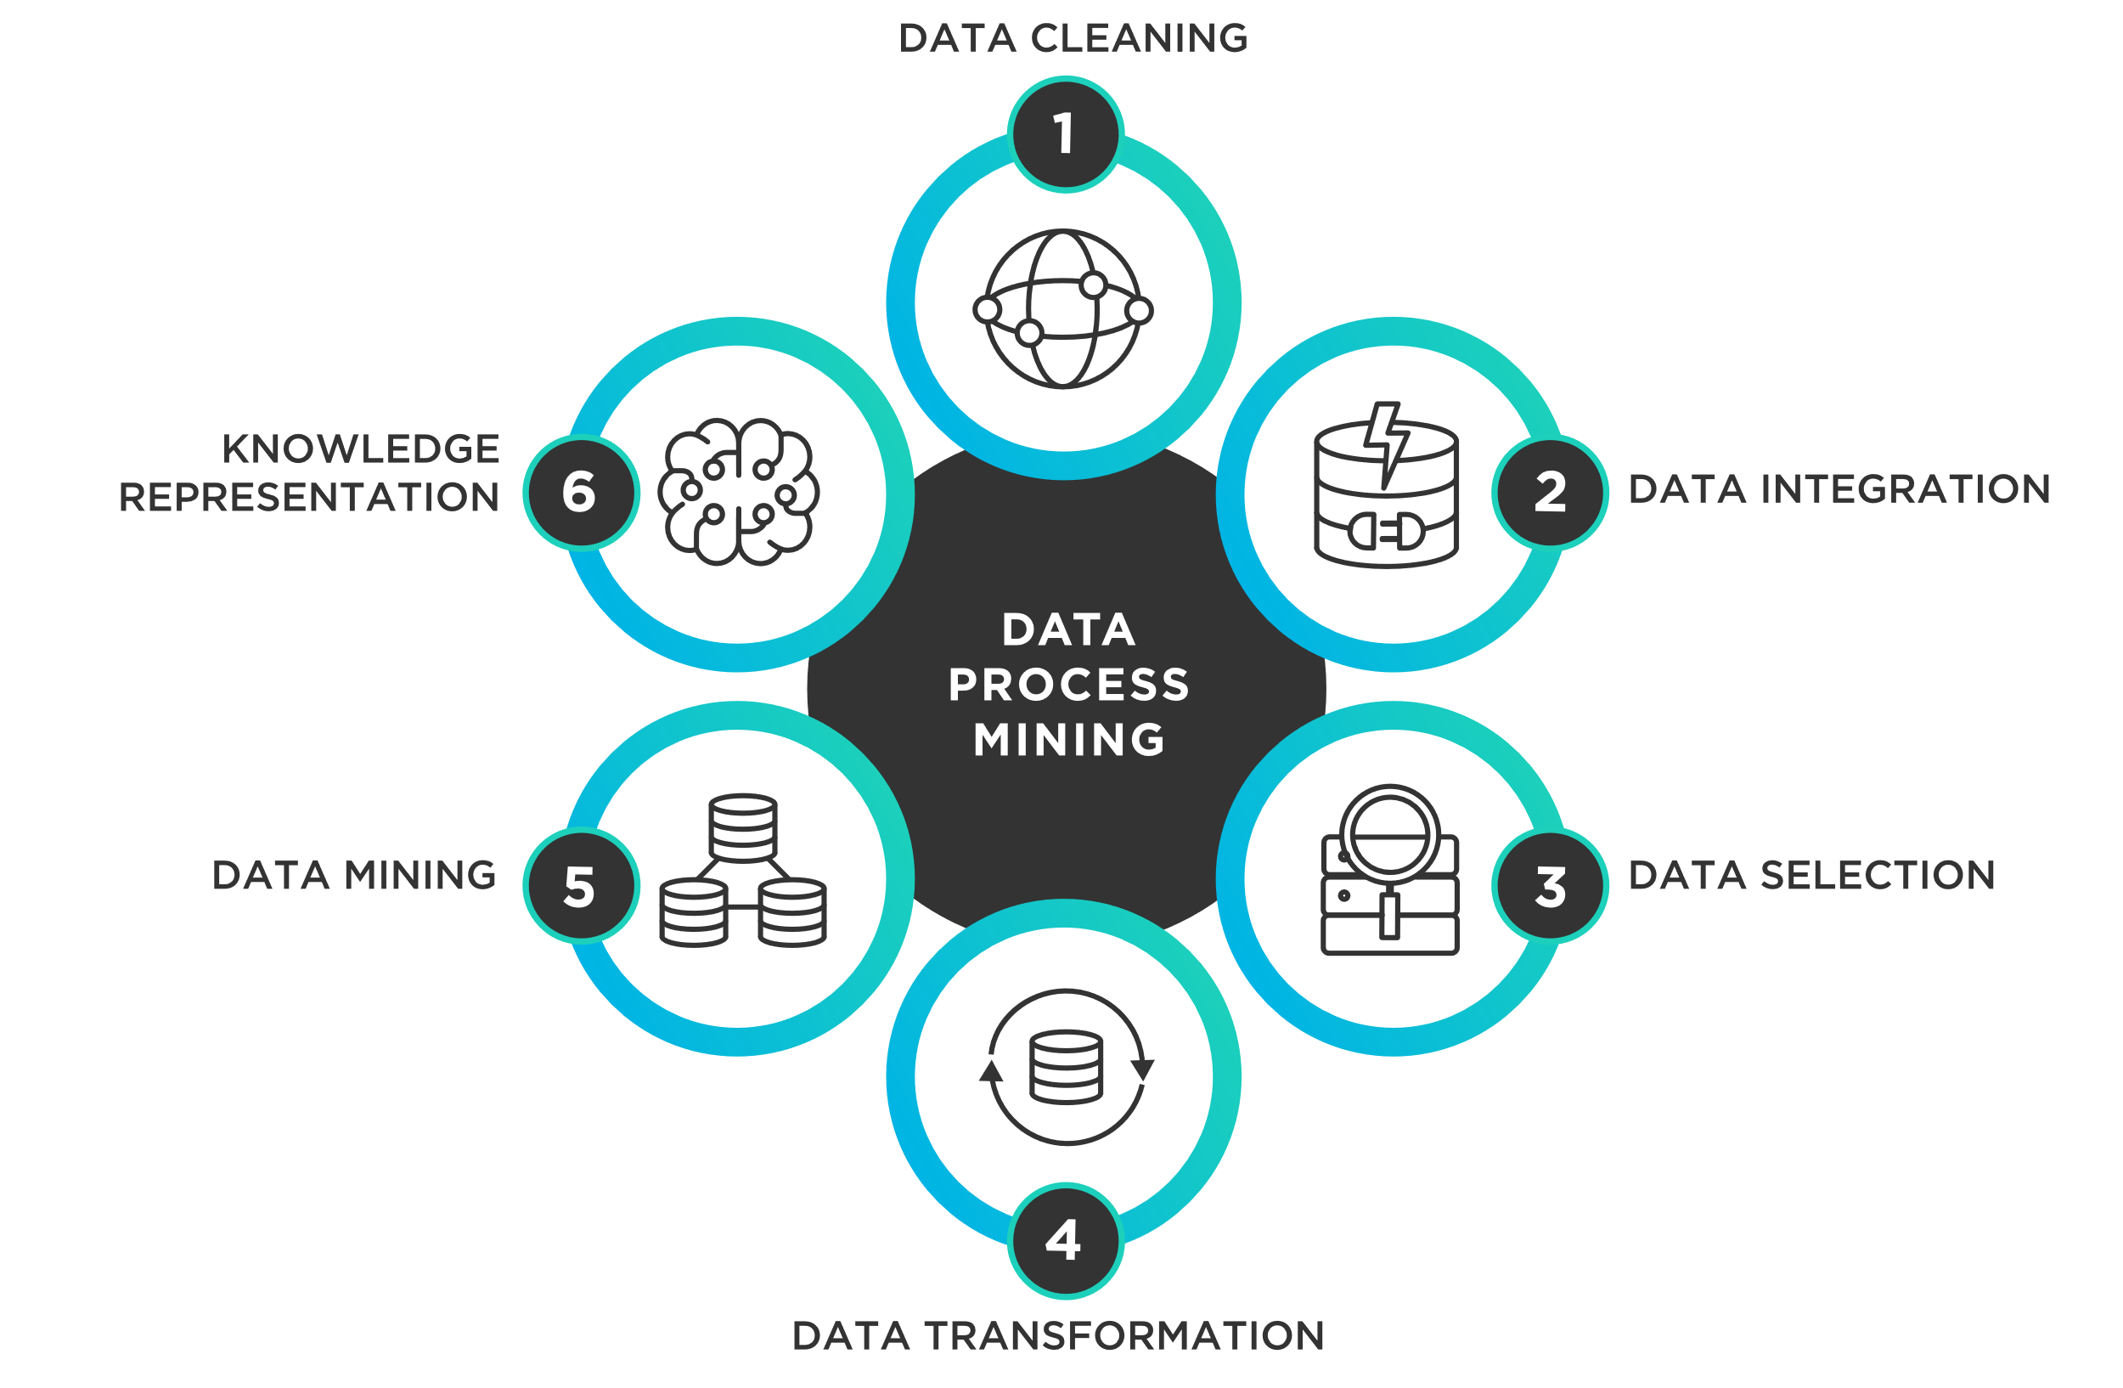
ÚVOD
Data mining
Feature selection (variable selection, attribute selection, variable subset selection)
Metaheuristic algorithms
Dragonfly algorithm
Binary Dragonfly algorithm

Slide 4
Dragonfly algorithm
Notes:
Gl and pl [0,1]
As given in Eq. (12), the pl and gl played important roles in
the learning process. If the values of pl and gl are too low, the
algorithm will mostly search around the personal best and global
best solutions, which is easily getting trapped in the local optima.
On the contrary, the position updating process will likely similar
to BDA if the values of pl and gl are too high.

Slide 5
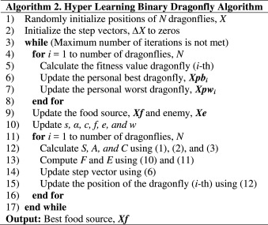
Hyper Learning Binary Dragonfly Algorithm
Hyperlearning
Personal best and global best solutions
personal learning rate
global learning rate
Notes:
Gl and pl [0,1]
As given in Eq. (12), the pl and gl played important roles in
the learning process. If the values of pl and gl are too low, the
algorithm will mostly search around the personal best and global
best solutions, which is easily getting trapped in the local optima.
On the contrary, the position updating process will likely similar
to BDA if the values of pl and gl are too high.

Slide 6
Případová studie Covid-19
Covid-19 Dataset (Github: Covid-19-Patient-Health-Analytics)
Předpověď zdravotního stavu pacienta

Slide 7

závěr
Benchmark
Aplikační opodstatnění

Slide 8
Děkuju za pozornost
Ústav automatizace a informatiky
Fakulta strojního inženýrství
Vysoké učení technické v Brně
Martin Juříček

Slide 9
Notes:
Úvodní slide obecný. Použijte pouze jeden úvodní slide, druhý smažte.

